Slide 1
Reading Research

Slide 2
Administrative Preliminaries
Names, &c.
Office hours: would you like reservations to be possible, or purely drop-in?
Upcoming assignments
For next time (September 12): summarize each reading we’ll discuss next session
The first reading, by Andrew Enterline, is optional: it’s not an example of research
This is a “turn something at all plausible in, get full credit” assignment
Try to figure out what might be useful or interesting to you
Jargon foreshadowing: “independent” and “dependent” variables
For September 19: Journal Report
Journals posted to Canvas announcements, also added to assignments
(You’re not committed; talk to me if change is desired—or if links break!)

Slide 3
Hoover Green: Background

Slide 4
Hoover Green: Background

Slide 5
Hoover Green: Background
Reading in groups

Slide 6
Hoover Green: Background
Reading in groups
Journals and presses

Slide 7
(Yabo)
(Corey)
(CeCe)
(Cody)
(Brady)
(Paige)
(Katie)

Slide 8
Hoover Green: Background
Reading in groups
Journals and presses
And, sotto voce, affiliations and identities

Slide 9
Hoover Green: Background
Reading in groups
Journals and presses
And, sotto voce, affiliations and identities
Read with skepticism, but not too much

Slide 10
Hoover Green: Background
Reading in groups
Journals and presses
And, sotto voce, affiliations and identities
Read with skepticism, but not too much
Standard paper/article organization

Slide 11
Hoover Green: Background
Reading in groups
Journals and presses
And, sotto voce, affiliations and identities
Read with skepticism, but not too much
Standard paper/article organization
If you peeked ahead to next week’s first reading…

Slide 12
Hoover Green: Background
Reading in groups
Journals and presses
And, sotto voce, affiliations and identities
Read with skepticism, but not too much
Standard paper/article organization
If you peeked ahead to next week’s first reading…
First, theory: what’s the question? Then, empirics: what’s the answer?

Slide 13
Hoover Green: Background
Reading in groups
Journals and presses
And, sotto voce, affiliations and identities
Read with skepticism, but not too much
Standard paper/article organization
If you peeked ahead to next week’s first reading…
First, theory: what’s the question? Then, empirics: what’s the answer?
Exploratory vs. inferential research

Slide 14
Hoover Green: Background
Reading in groups
Journals and presses
And, sotto voce, affiliations and identities
Read with skepticism, but not too much
Standard paper/article organization
If you peeked ahead to next week’s first reading…
First, theory: what’s the question? Then, empirics: what’s the answer?
Exploratory vs. inferential research
When you know the topic, conjecture what the results will be

Slide 15
Hoover Green: Content
What’s her advice?

Slide 16
Hoover Green: Content
What’s her advice?
Is that advice sound? Context-dependent? Well-organized?

Slide 17
Hoover Green: Content
What’s her advice?
Is that advice sound? Context-dependent? Well-organized?
When reading, it’s always worth evaluating what did or didn’t persuade, and why

Slide 18
Hoover Green: Content
What’s her advice?
Is that advice sound? Context-dependent? Well-organized?
When reading, it’s always worth evaluating what did or didn’t persuade, and why
Think about how you could extend or improve whatever you’re reading

Slide 19
Hoover Green: Content
What’s her advice?
Is that advice sound? Context-dependent? Well-organized?
When reading, it’s always worth evaluating what did or didn’t persuade, and why
Think about how you could extend or improve whatever you’re reading
Summaries: abstract (for articles), introduction, conclusion

Slide 20
Hoover Green: Content
What’s her advice?
Is that advice sound? Context-dependent? Well-organized?
When reading, it’s always worth evaluating what did or didn’t persuade, and why
Think about how you could extend or improve whatever you’re reading
Summaries: abstract (for articles), introduction, conclusion
Her emphasis on causation, counterargument, and assumptions is telling about what social scientists see as research’s goals

Slide 21
Hoover Green: Content
What’s her advice?
Is that advice sound? Context-dependent? Well-organized?
When reading, it’s always worth evaluating what did or didn’t persuade, and why
Think about how you could extend or improve whatever you’re reading
Summaries: abstract (for articles), introduction, conclusion
Her emphasis on causation, counterargument, and assumptions is telling about what social scientists see as research’s goals
Examples and narrative detail are typically secondary

Slide 22
Another View: Edwards

Slide 23
Another View: Edwards
Decide in advance how much time you will spend

Slide 24
Another View: Edwards
Decide in advance how much time you will spend
Read actively: follow your goals, not the author’s

Slide 25
Another View: Edwards
Decide in advance how much time you will spend
Read actively: follow your goals, not the author’s
Read it three times: for overview, for detail, for synthesis

Slide 26
Another View: Edwards
Decide in advance how much time you will spend
Read actively: follow your goals, not the author’s
Read it three times: for overview, for detail, for synthesis
Focus on parts with high information content

Slide 27
Another View: Edwards
Decide in advance how much time you will spend
Read actively: follow your goals, not the author’s
Read it three times: for overview, for detail, for synthesis
Focus on parts with high information content
Mark up the reading with your own notes

Slide 28
Another View: Edwards
Decide in advance how much time you will spend
Read actively: follow your goals, not the author’s
Read it three times: for overview, for detail, for synthesis
Focus on parts with high information content
Mark up the reading with your own notes
You need not take any of these systems as gospel: the key point is to find what works for you

Slide 29
Another View: Edwards
Decide in advance how much time you will spend
Read actively: follow your goals, not the author’s
Read it three times: for overview, for detail, for synthesis
Focus on parts with high information content
Mark up the reading with your own notes
You need not take any of these systems as gospel: the key point is to find what works for you
Grad-school advice: record quick summaries of every piece of research you read

Slide 30
Woessner and Kelly-Woessner
Any questions?

Slide 31
Woessner and Kelly-Woessner
What do they have to say? What are their central claims, and how do they attempt to show that those claims are correct?

Slide 32
Woessner and Kelly-Woessner
What do they have to say? What are their central claims, and how do they attempt to show that those claims are correct?
Terminology: “panel study,” “regression to the mean,” “operational identity”…

Slide 33
Woessner and Kelly-Woessner
What do they have to say? What are their central claims, and how do they attempt to show that those claims are correct?
Terminology: “panel study,” “regression to the mean,” “operational identity”…
How much do we need to know?

Slide 34
Woessner and Kelly-Woessner
What do they have to say? What are their central claims, and how do they attempt to show that those claims are correct?
Terminology: “panel study,” “regression to the mean,” “operational identity”…
How much do we need to know?
Are you convinced? What of? What convinces you?

Slide 35
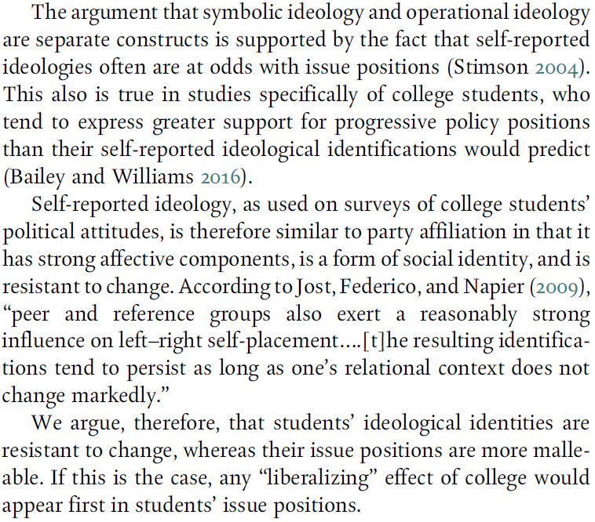
Woessner and Kelly-Woessner
What do they have to say? What are their central claims, and how do they attempt to show that those claims are correct?
Terminology: “panel study,” “regression to the mean,” “operational identity”…
How much do we need to know?
Are you convinced? What of? What convinces you?

Slide 36
Woessner and Kelly-Woessner
What do they have to say? What are their central claims, and how do they attempt to show that those claims are correct?
Terminology: “panel study,” “regression to the mean,” “operational identity”…
How much do we need to know?
Are you convinced? What of? What convinces you?
Main
claim

Slide 37
Woessner and Kelly-Woessner
What do they have to say? What are their central claims, and how do they attempt to show that those claims are correct?
Terminology: “panel study,” “regression to the mean,” “operational identity”…
How much do we need to know?
Are you convinced? What of? What convinces you?
Corollary
Main
claim

Slide 38
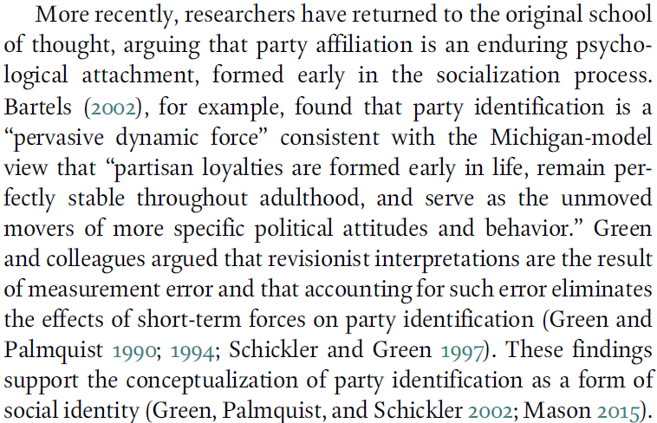
Woessner and Kelly-Woessner
What do they have to say? What are their central claims, and how do they attempt to show that those claims are correct?
Terminology: “panel study,” “regression to the mean,” “operational identity”…
How much do we need to know?
Are you convinced? What of? What convinces you?
Argument Supporting Claim

Slide 39
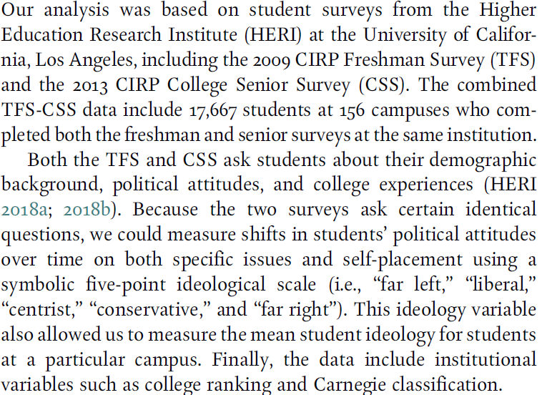
Woessner and Kelly-Woessner
What do they have to say? What are their central claims, and how do they attempt to show that those claims are correct?
Terminology: “panel study,” “regression to the mean,” “operational identity”…
How much do we need to know?
Are you convinced? What of? What convinces you?
Evidence to Examine Claim

Slide 40
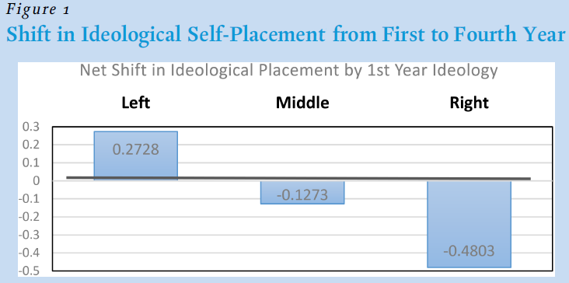
Woessner and Kelly-Woessner
What do they have to say? What are their central claims, and how do they attempt to show that those claims are correct?
Terminology: “panel study,” “regression to the mean,” “operational identity”…
How much do we need to know?
Are you convinced? What of? What convinces you?

Slide 41
Woessner and Kelly-Woessner
What do they have to say? What are their central claims, and how do they attempt to show that those claims are correct?
Terminology: “panel study,” “regression to the mean,” “operational identity”…
How much do we need to know?
Are you convinced? What of? What convinces you?
Does this support the authors’ theory?

Slide 42
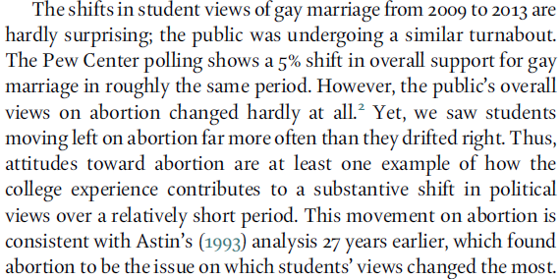
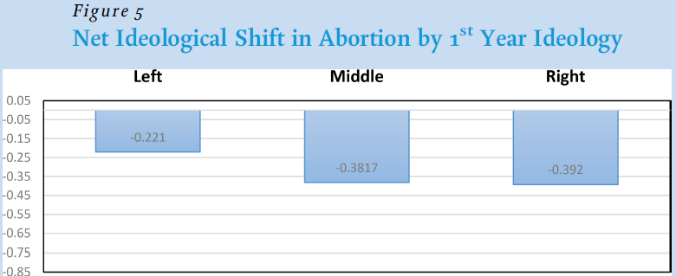
Woessner and Kelly-Woessner
What do they have to say? What are their central claims, and how do they attempt to show that those claims are correct?
Terminology: “panel study,” “regression to the mean,” “operational identity”…
How much do we need to know?
Are you convinced? What of? What convinces you?

Slide 43
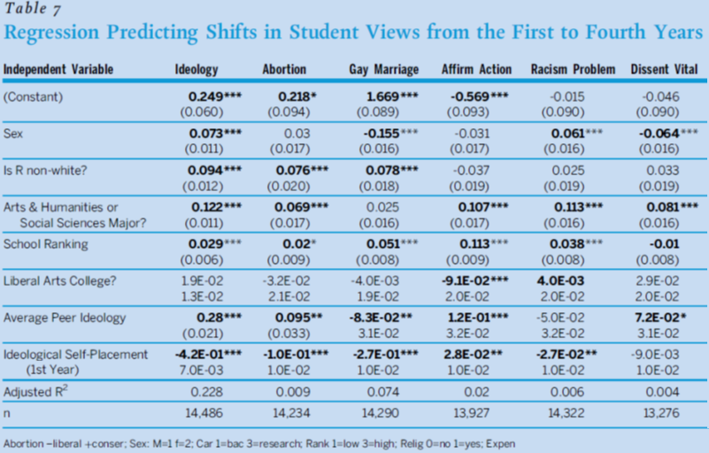
Woessner and Kelly-Woessner
What do they have to say? What are their central claims, and how do they attempt to show that those claims are correct?
Terminology: “panel study,” “regression to the mean,” “operational identity”…
How much do we need to know?
Are you convinced? What of? What convinces you?

Slide 44
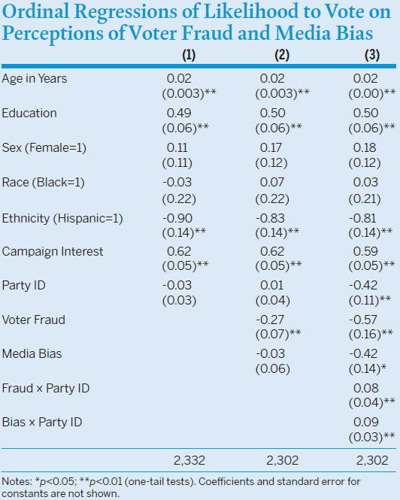

Slide 45
Dependent variable

Slide 46
Dependent variable
Independent variables

Slide 47
Dependent variable
Independent variables

Slide 48
Dependent variable
Independent variables

Slide 49

Dependent variable
Independent variables

Slide 50




Dependent variable
Independent variables

Slide 51
Dependent variable
Independent variables
Coefficient signs

Slide 52
Dependent variable
Coefficient sizes
Independent variables
Coefficient signs

Slide 53
Dependent variable
Coefficient sizes
Independent variables
Statistical confidence
Coefficient signs

Slide 54
Dependent variable
Coefficient sizes
Independent variables
Statistical confidence
Coefficient signs

Slide 56
Statistical Results

Slide 57
Statistical Results
Theory: why would the authors expect some relationship?

Slide 58
Statistical Results
Theory: why would the authors expect some relationship?
Measurement: how were the concepts computed?

Slide 59
Statistical Results
Theory: why would the authors expect some relationship?
Measurement: how were the concepts computed?
Relationships: what variables associate (correlate) with others?

Slide 60
Statistical Results
Theory: why would the authors expect some relationship?
Measurement: how were the concepts computed?
Relationships: what variables associate (correlate) with others?
Confidence: how sure are the authors of their findings?

Slide 61
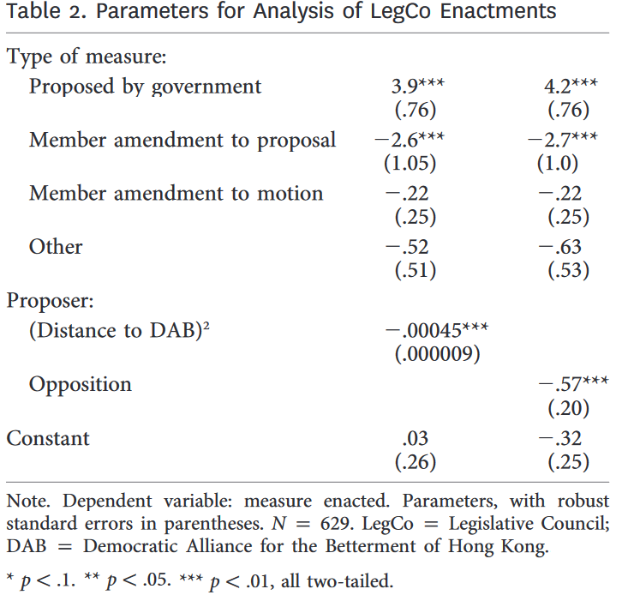
Notes:
From Smyth, Regina, William Bianco, and Kwan Nok Chan. “Legislative Rules in Electoral Authoritarian Regimes: The Case of Hong Kong’s Legislative Council.” Journal of Politics 81:3, 892–905.

Slide 62
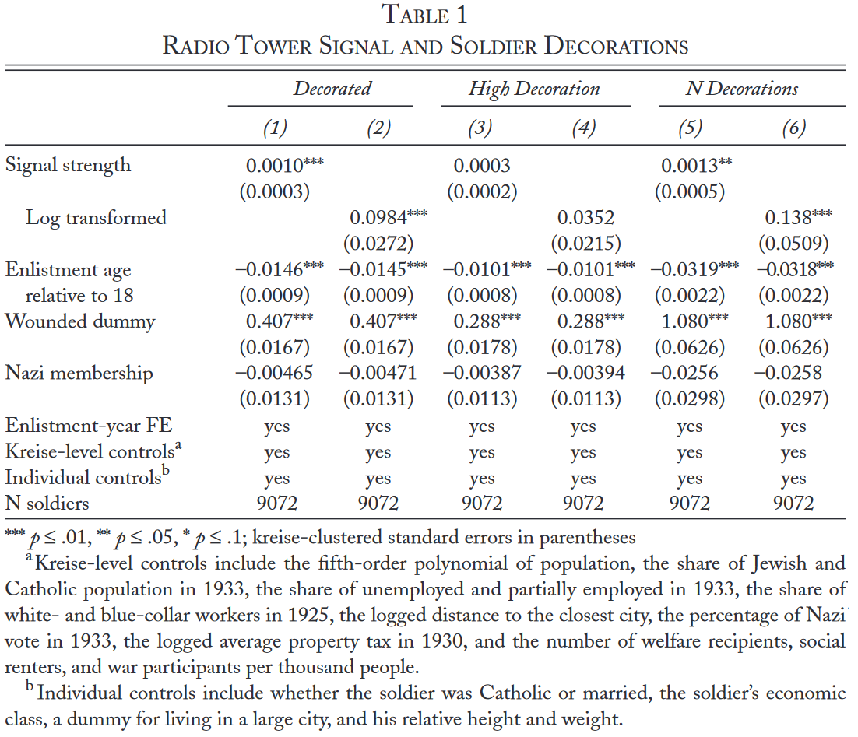
Notes:
From Barber, Benjamin, and Charles Miller. 2019. “Propaganda and Combat Motivation: Radio Broadcasts and German Soldiers’ Performance in World War II.” World Politics 71:3, 457–502.

Slide 63
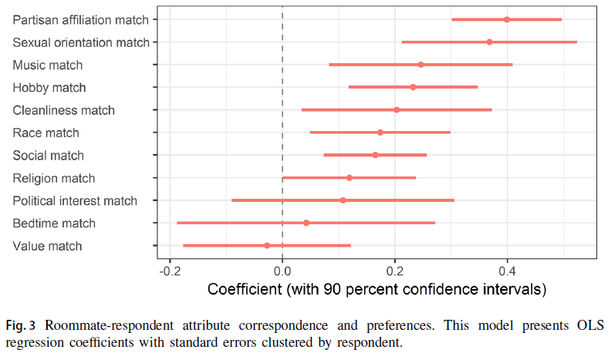
Notes:
From Shafranek, Richard M. 2021. “Political Considerations in Nonpolitical Decisions: A Conjoint Analysis of Roommate Choice." Political Behavior 43:1, 271–300.

Slide 64
Woessner and Kelly-Woessner
What do they have to say? What are their central claims, and how do they attempt to show that those claims are correct?
Terminology: “panel study,” “regression to the mean,” “operational identity”…
How much do we need to know?
Are you convinced? What of? What convinces you?

Slide 65
Goldsmith et al.
What are their central claims?

Slide 66
Goldsmith et al.
What are their central claims?
Are those claims surprising? banal? important? generalizable through time?

Slide 67
Goldsmith et al.
What are their central claims?
Are those claims surprising? banal? important? generalizable through time?
Why do they believe their claims: what’s the reasoning?

Slide 68
Goldsmith et al.
What are their central claims?
Are those claims surprising? banal? important? generalizable through time?
Why do they believe their claims: what’s the reasoning?
Does their logic make sense? Is it the logic you would have come up with had you been asked to conjecture why someone might believe this?

Slide 69
Goldsmith et al.
What are their central claims?
Are those claims surprising? banal? important? generalizable through time?
Why do they believe their claims: what’s the reasoning?
Does their logic make sense? Is it the logic you would have come up with had you been asked to conjecture why someone might believe this?
What evidence did they use?

Slide 70
Goldsmith et al.
What are their central claims?
Are those claims surprising? banal? important? generalizable through time?
Why do they believe their claims: what’s the reasoning?
Does their logic make sense? Is it the logic you would have come up with had you been asked to conjecture why someone might believe this?
What evidence did they use?
Is this a good way to study what they’re aiming to? Could you think of alternative ways to get evidence about the question?

Slide 71
Goldsmith et al.
What are their central claims?
Are those claims surprising? banal? important? generalizable through time?
Why do they believe their claims: what’s the reasoning?
Does their logic make sense? Is it the logic you would have come up with had you been asked to conjecture why someone might believe this?
What evidence did they use?
Is this a good way to study what they’re aiming to? Could you think of alternative ways to get evidence about the question?
Are views of the leader interchangeable with views about the country? Is this public diplomacy or personal PR?

Slide 72
Goldsmith et al.
What are their central claims?
Are those claims surprising? banal? important? generalizable through time?
Why do they believe their claims: what’s the reasoning?
Does their logic make sense? Is it the logic you would have come up with had you been asked to conjecture why someone might believe this?
What evidence did they use?
Is this a good way to study what they’re aiming to? Could you think of alternative ways to get evidence about the question?
Are views of the leader interchangeable with views about the country? Is this public diplomacy or personal PR?

Slide 73
Goldsmith et al.
What are their central claims?
Are those claims surprising? banal? important? generalizable through time?
Why do they believe their claims: what’s the reasoning?
Does their logic make sense? Is it the logic you would have come up with had you been asked to conjecture why someone might believe this?
What evidence did they use?
Is this a good way to study what they’re aiming to? Could you think of alternative ways to get evidence about the question?
Are views of the leader interchangeable with views about the country? Is this public diplomacy or personal PR?
Would you expect the effect to be the same regardless of the leader involved?

Slide 74
Goldsmith et al.
What are their central claims?
Are those claims surprising? banal? important? generalizable through time?
Why do they believe their claims: what’s the reasoning?
Does their logic make sense? Is it the logic you would have come up with had you been asked to conjecture why someone might believe this?
What evidence did they use?
Is this a good way to study what they’re aiming to? Could you think of alternative ways to get evidence about the question?
Are views of the leader interchangeable with views about the country? Is this public diplomacy or personal PR?
Would you expect the effect to be the same regardless of the leader involved?

Slide 75
Goldsmith et al.
What are their central claims?
Are those claims surprising? banal? important? generalizable through time?
Why do they believe their claims: what’s the reasoning?
Does their logic make sense? Is it the logic you would have come up with had you been asked to conjecture why someone might believe this?
What evidence did they use?
Is this a good way to study what they’re aiming to? Could you think of alternative ways to get evidence about the question?
Are views of the leader interchangeable with views about the country? Is this public diplomacy or personal PR?
What leader characteristics would you expect to affect the impact of the visit?

Slide 76
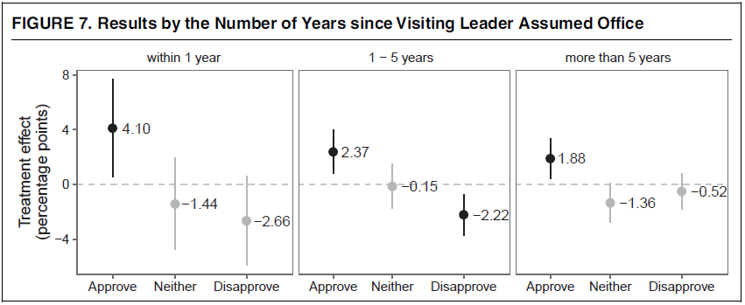
Goldsmith et al.
What are their central claims?
Are those claims surprising? banal? important? generalizable through time?
Why do they believe their claims: what’s the reasoning?
Does their logic make sense? Is it the logic you would have come up with had you been asked to conjecture why someone might believe this?
What evidence did they use?
Is this a good way to study what they’re aiming to? Could you think of alternative ways to get evidence about the question?
Are views of the leader interchangeable with views about the country? Is this public diplomacy or personal PR?
What leader characteristics would you expect to affect the impact of the visit?

Slide 77
Goldsmith et al.
What do they find regarding their central claim? Were they correct?

Slide 78
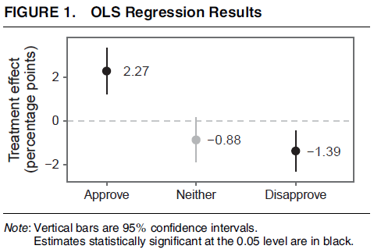
Goldsmith et al.
What do they find regarding their central claim? Were they correct?

Slide 79
Goldsmith et al.
What do they find regarding their central claim? Were they correct?
What does this “2.27” mean substantively? (Is it large?)

Slide 80
Goldsmith et al.
How do we interpret the confidence interval?
What do they find regarding their central claim? Were they correct?

Slide 81
Goldsmith et al.
What do they find regarding their central claim? Were they correct?

Slide 82
Goldsmith et al.
What do they find regarding their central claim? Were they correct?
What else do they find of note, if anything?
“Of note” can mean unexpected, interesting, informative about other questions…

Slide 83
In Summary
Most research works involve a question and an answer to look out for

Slide 84
In Summary
Most research works involve a question and an answer to look out for
A question is more than a topic (though that’s part of it)

Slide 85
In Summary
Most research works involve a question and an answer to look out for
A question is more than a topic (though that’s part of it)
How the answer was derived can be as important as what the answer was

Slide 86
In Summary
Most research works involve a question and an answer to look out for
A question is more than a topic (though that’s part of it)
How the answer was derived can be as important as what the answer was
Gives ways to explain disagreement and suggests contexts where the results apply

Slide 87
In Summary
Most research works involve a question and an answer to look out for
A question is more than a topic (though that’s part of it)
How the answer was derived can be as important as what the answer was
Gives ways to explain disagreement and suggests contexts where the results apply
Beware confirmation bias! Don’t only pick apart things you disagree with

Slide 88
In Summary
Most research works involve a question and an answer to look out for
A question is more than a topic (though that’s part of it)
How the answer was derived can be as important as what the answer was
Gives ways to explain disagreement and suggests contexts where the results apply
Beware confirmation bias! Don’t only pick apart things you disagree with
Don’t be afraid to use your own judgment or disagree, while recognizing that the author probably has spent some time thinking about things

Slide 89
In Summary
Most research works involve a question and an answer to look out for
A question is more than a topic (though that’s part of it)
How the answer was derived can be as important as what the answer was
Gives ways to explain disagreement and suggests contexts where the results apply
Beware confirmation bias! Don’t only pick apart things you disagree with
Don’t be afraid to use your own judgment or disagree, while recognizing that the author probably has spent some time thinking about things
If something seems important but you’re not sure you understand or are sure you don’t, ask a professor: it’s what we’re here for

